Slide 1
Polish Info Day
EU4Health 2021-2027
European Health and Digital Executive Agency (HaDEA) Europejska Agencja Wykonawcza ds. Zdrowia i Cyfryzacji
Anna BULZACKA-BOGUCKA – Project Advisor
Warsaw, 21 February 2023

Slide 2
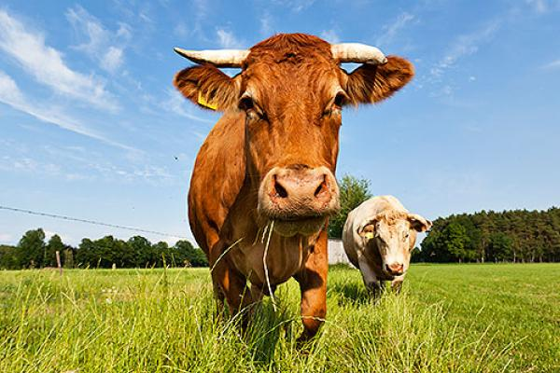
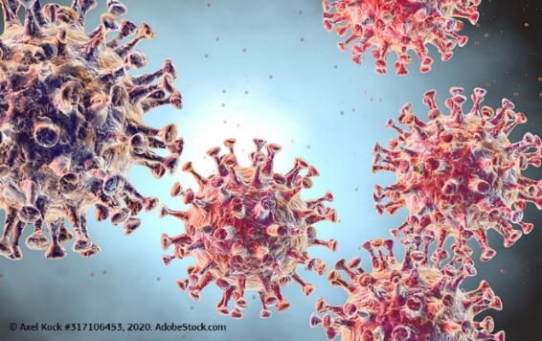
HaDEA Dept. A: Health & Food
EU4HEALTH
Improve and foster health in the Union
Protect people in the Union from serious cross-border threats to health
Make medicines available and affordable
Strengthen health systems, their resilience and resource efficiency
Single Market Programme - Food safety
Ensure a high level of health for humans, animals and plants, and the safety of food and feed
Prevent, detect and eradicate animal diseases & plant pests
Support the welfare of animals
Fight against antimicrobial resistance
Develop sustainable food production and consumption
Ensure reliable official controls
HE Cluster 1 - Health
D1: Staying healthy in a rapidly changing society
D2: Living and working in a health-promoting environment
D.3: Tackling diseases & reducing disease burden
D4: Ensuring access to innovative, sustainable & high-quality Healthcare
D.5: Unlocking the full potential of new tools, technologies and digital solutions for a healthy society
D.6: Maintaining an innovative, sustainable & globally competitive health industry

Slide 3
DG SANTE
HaDEA
Information Days, Guidelines, etc.
Policy Priorities
Publication of Calls
External Evaluation (Projects, JA, etc.)
Yearly Workplan
Evaluation
EC internal evaluation (Tenders, Direct Grants)
Negotiation/
Contracting
External Evaluation
Monitoring/
Payments
Audits
Dissemination
Publications, webpages, etc.
Policy Development
Summary reports, meetings
MS Contacts
Archiving
Notes:
Implement the Programmes
carry out all the operations necessary for the management of the programme, in particular those linked to the award of contracts and grants
Disseminate know-how and best practices
Feed back projects results to DGs policy officers
Provide logistical, scientific and technical support by organising technical meetings, preparatory studies, seminars or conferences
Foster exchange and co-ordination between all players involved
Contribute to improve the PH programme

Slide 4
EU4Health programme
Program UE dla zdrowia powstał w odpowiedzi na pandemię COVID-19, w celu zwiększenia gotowości na sytuacje kryzysowe w UE i pomocy w długoterminowych wyzwaniach w dziedzinie zdrowia przez budowanie silniejszych, odporniejszych i bardziej dostępnych systemów opieki zdrowotnej.
It demonstrates that public health is a priority for the EU and it is one of the main instruments to pave the way to a European Health Union. EU4Health brings an EU added value and complements the policies of Member States.

Slide 5
EU4Health general goals – cele ogólne
Improve and foster
health in the Union
Protect people in the Union from serious cross- border threats
to health
Make medicines available and
affordable
Strengthen health systems, their
resilience and
resource efficiency
Poprawa i wspieranie zdrowia
Poprawa dostepnosci i przystepnosci cenowej produktow leczniczych i wyrobow medycznych
Ochrona ludnosci przed powaznymi transgranicznymi zagrozeniami dla zdrowia
Wzmocnienie systemow opieki zdrowotnej

Slide 6
Specific objectives and strands of action

Slide 7
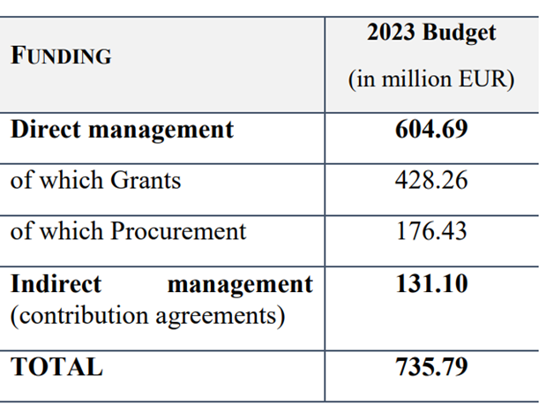
EU4Health 2023 Work Programme
For more information: https://health.ec.europa.eu/publications/2023-eu4health-work-programme_en

Slide 8
Types of EU4Health grants
Procedure type | How will you learn about the opportunity? | Type of applicants targeted
Direct grant to Member States (joint action) in accordance with Article 195, first paragraph, point (c), of Regulation (EU, Euratom) 2018/1046 | Requires nomination from your country | One Competent Authority per Joint Action and country (can affiliate entities with legal or capital link)
Direct grants to bodies identified by the basic act in accordance with Article 195, first paragraph, point (d), of Regulation (EU, Euratom) 2018/1046 |  | Specific entities as defined in the call text
Open call for proposals (action grants) | Published on Funding and Tenders portal | Range of stakeholders e.g. science, academia, health authorities/institutions, NGOs…as defined in the call text
…

Slide 9
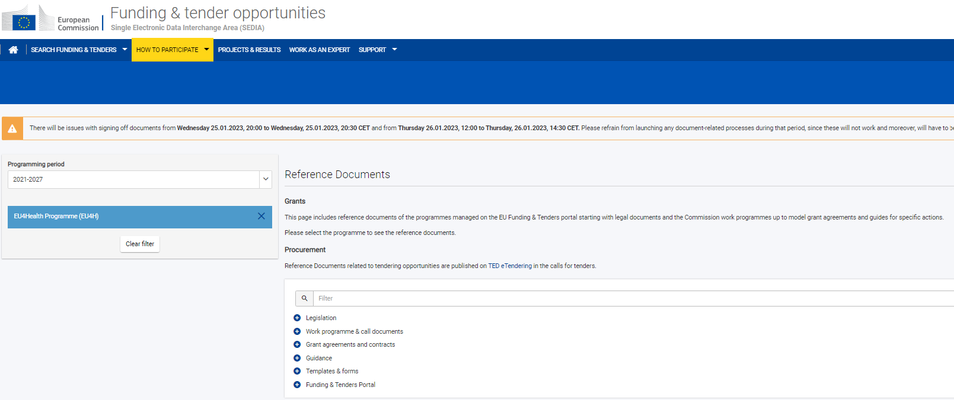
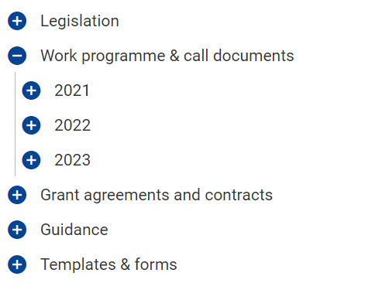
Where to find it?
EC Funding and Tenders Portal:
https://ec.europa.eu/info/funding-tenders/opportunities/portal/screen/home

Slide 10
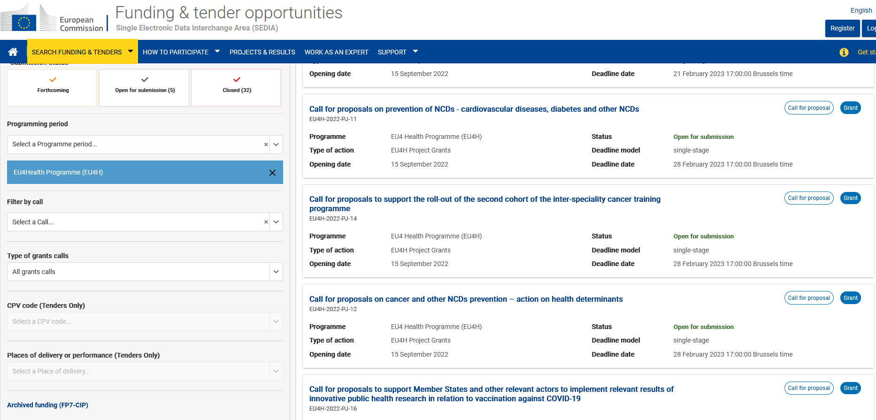
Where to find open calls?

Slide 11
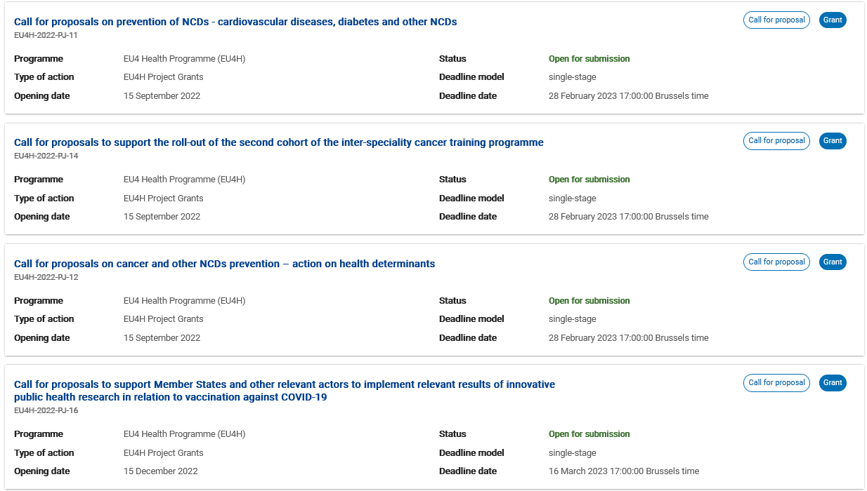
Current opportunities and open calls (2022-2023)

Slide 12
Dziękuję za uwagę
© European Union 2020
Unless otherwise noted the reuse of this presentation is authorised under the CC BY 4.0 license. For any use or reproduction of elements that are not owned by the EU, permission may need to be sought directly from the respective right holders.
Slide xx: element concerned, source: e.g. Fotolia.com; Slide xx: element concerned, source: e.g. iStock.com
Notes:
Update/add/delete parts of the copy right notice where appropriate.
More information: https://myintracomm.ec.europa.eu/corp/intellectual-property/Documents/2019_Reuse-guidelines%28CC-BY%29.pdf

