Slide 1
Professionalization of Public Procurement
September 24, 2024

Slide 2
Outline of session
Background to World Bank support
Why professionalization is important
Overview of ProcurCompEU
International examples
Guidelines to introduce ProcurCompEU
Polish experiences and lessons learned
Next steps

Slide 3
Background
World Bank support to the Polish government on implementing three aspects of the State Purchasing Policy
Approach to implementation
Stakeholders’ engagement
Green public procurement
Increasing the participation of SMEs
Focus groups
Data analysis
Research and analysis
Professionalization of public procurement
Round table consultations
Pilots

Slide 4
Professionalization: scope of activities
Assessment of the current status of professionalization in Poland
Polish public procurement system: main functions and institutional landscape
Polish Public Procurement System: performance
Legal and policy framework for public employees in Poland
Current Position on Professionalization of Public Procurement
Gap analysis and recommendations for full implementation of the State Purchasing Policy
Guidelines to implement ProcurCompEU
Pilots, communication and dissemination

Slide 5
Why professionalize public procurement?
For the society – high-quality public services and efficient use of public funds
For the government/contracting authorities – achieved policy objectives, enhanced public trust and reduced administrative costs
For the procurement practitioners - raise the status of public procurement as a profession, higher prestige, higher credibility, better opportunities for career development and better training opportunities

Slide 6
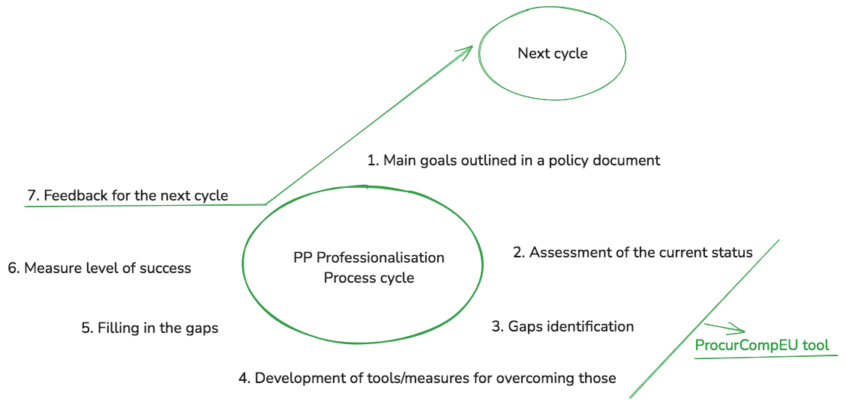
Public procurement professionalization process

Slide 7
The European competency framework for procurement professionals - ProcurCompEU
A tool designed by the European Commission to support the professionalization of public procurement.
Provides a common reference for PP professionals in the European Union and beyond.
Aim is to support all procurement practitioners and procurement units to reach their full potential → raise the status of public procurement as a profession
It recognizes and supports public procurement as a strategic function that delivers public investment for sustainable growth.

Slide 8
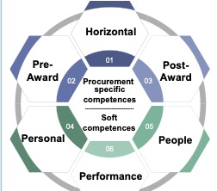
Background on ProcurCompEU
a common framework of reference to assist public sector to self-assess its competency gaps in PP area
facilitates training and development
30 standard competences for public procurement
each defined at four proficiency levels: Basic, Intermediate, Advanced, Expert
3 elements – competency matrix, self-assessment tool and generic training curriculum

Slide 9
Background on ProcurCompEU
the competency matrix - outlines the competences and skills PP professionals should have depending on the role they perform
the self-assessment tool could be used to assess the PP practitioners’ and public organizations’ levels of proficiency and organisational maturity in the competences identified in the competency matrix
the generic training curriculum shows how government administrations can upskill their procurement professionals

Slide 10
ProcurCompEU international experience
Romania – local competency frameworks and training curricula - (i) public procurement counsellor (PPC)and (ii) public procurement system counsellor (PPSC) competency frameworks and corresponding training curricula.
Malta* – organizational maturity assessment and a pilot for recognizing on the job learning - a pilot programme on Recognition for Prior Learning (RPL);
Costa Rica** - to assess organizational maturity (2 entities)
Chile** – update of the national certification schemes by modernizing the competency matrix
Italy ** - tailor training offer for regional CPBs.
Source: EC
* Source: EC
** Source: OECD

Slide 11
International examples of policy driven and coordinated capacity building initiatives
Scotland - the Public Procurement Reform Programme => reform board, centres of excellence, procurement journey, information hub, competency framework, assessment of capability development within the Procurement and Commercial Improvement Plan (PCIP), Procurement People of Tomorrow (PPoT) program, Scotland Excel Academy
Romania - PP Strategy => competency frameworks, web guide, training curriculum, pilots – CAs capacity building, PP professionalization strategy
New Zealand – Government Procurement Reform, Procurement Rules, Procurement Academy, Procurement for the future strategy, 4 priority outcomes, online learning platform
Australia – Procurement Policy, Centre of Procurement Excellence, Procurement and Contract Management Community of Practice, Procurement and Contract Management Awards for Excellence program, Procurement Bulletin, Procurement and Contract Management Capability Self-Assessment Survey
Bulgaria – PP Strategy, design and implementation of the Bulgarian Public Procurement Training and Development Programme
Botswana - E-Learning, e-learning strategy, Curriculum Development and Capacity Building in Public Sector Management
Bhutan - Gross National Happiness Model for Pursuing Sustainable Public Procurement

Slide 12
ProcurCompEU guidelines
State Purchasing Policy has 5 steps for implementing ProcurComp^{EU}
Adapt the competency matrix
Define the job profiles
Perform self-assessment
Identify the gaps
Address the gaps

Slide 13
Roles and responsibilities in implementing ProcurCompEU
Ministry of Economic Development and Science
Contracting authorities
Implement SPP, including ProcurComp^{EU}, send data on competency gaps to PPO, ensure staff is trained
Procurement practitioners
Conduct self-assessment, develop a training plan, attend trainings and raise skills and knowledge
Public Procurement Agency
Plans, develops, coordinates and monitors the State Purchasing Policy
SPP's monitoring, collect data on competency gaps, guidance, trainings, good practice sharing

Slide 14
ProcurCompEU Guidelines – what they are?
Step-by-step instructions, a roadmap for implementing ProcurComp^{EU} in central and local contracting authorities
A clear and concise overview of the process, including steps that can be taken to simplify the process in smaller contracting authorities
Detailed instructions on how to use the Competency Matrix and the Self-Assessment tool
Guidance on how to identify and address the competency gaps to support staff development and training needs
Recommendations on managing communication with an Example Question & Answer handout to support communications with staff
With additional examples of job profiles and target proficiency levels where procurement is only part of the job

Slide 15
ProcurCompEU Guidelines – added value
Intended for managers in contracting authorities
One additional step Step 0 included – preparation and communication
Guidance on how to simplify the process for smaller contracting authorities
Examples of job profiles and target proficiency levels where procurement is only part of the job
Example Question & Answer handout to support communications with staff

Slide 16
ProcurCompEU guidelines
STEP 0: Prepare to implement ProcurComp^{EU}
Familiarise yourself with the SPP and guidance
Coordinate with other units– HR, senior management
Manage communication with staff

Slide 17
ProcurCompEU guidelines
STEP 1: Adapt the competency matrix
Familiarise yourself with the competency matrix
Adapt the competency matrix to your organisation’s current and future needs

Slide 18
ProcurCompEU guidelines
STEP 2: Define the job profiles
Work out which jobs to include
Define the job profiles

Slide 19
ProcurCompEU guidelines
STEP 3: Perform self-assessment
Ensure staff and managers are prepared
Staff carry out the self-assessment
Line manager discusses the results with the individual
Moderate the self-assessments
Report the outcome of moderation to staff

Slide 20
ProcurCompEU guidelines
STEP 4: Identify the gaps
Collate organisational results
Report results to the PPO President
Communicate results to managers and staff

Slide 21
ProcurCompEU guidelines
STEP 5: Address the gaps
Identify organizational priority development needs
Identify options to meet the needs and choose
Managers agree individual development plans with staff

Slide 22
Experiences & lessons learned
Adaptable and flexible
Management’s involvement and support
Good planning
Communication
Cooperation at all levels
Coordination
Promoting a culture of continuous learning

Slide 23
Next steps
Further dissemination of the guidelines
Communication materials to facilitate the ProcurCompEU implementation – at central and local level
Monitoring and evaluation – to ensure the desired results

Slide 24
Questions? Carmen Calin Procurement Specialist World Bank ecalin@worldbank.org

