Slide 1
Looking for partners…
For Horizon Europe
Approaches and tools for security in software and hardware development and assessment
HORIZON-CL3-2024-CS-01-01
and/or
For Digital Europe
Deployment Actions in the area of Cybersecurity DIGITAL-ECCC-2024-DEPLOY-CYBER-07

Slide 2
South-Eastern Finland University of Applied Sciences, Xamk
12 000 degree
34 000 open university students
223
Projects, of which
31 international
1000 employees
Cybersecurity is our DIH spearhead
4 campuses
We have no partners yet and are looking for other 2-4 Universities (of Applied Sciences) from Poland/Baltics/Nordics.
Project idea with Ukraine ✅ We can be also a plug-in another project.
50 Bachelor’s
36 Masters’s Degree programmes
Marie Skavø-Sinisalo, Project Manager
marie.skavo-sinisalo@xamk.fi
+358 45 11 33787
Kaakkois-Suomen Ammattikorkeakoulu Oy www.xamk.fi
Business ID 2472908-2
VAT number FI24729082
Turnover 100 MEUR
RDI 32.1 MEUR

Slide 3
Free & open (source) SOC tools
Project Focus: Deployment of free and open solutions in European SMEs for enhanced cybersecurity by implementing cost-efficient SOC tools.
Suggested examples of used key technologies: SecurityOnion, Opensearch, ELK-stack etc.
For: Critical infrastructure SMEs & their immidiate suppliers in water utilities, energy and healthcare.
Why: major cybersecurity challenges for NIS2 SMEs, is the lack of low-budget solutions as well as experts / expertise.

Slide 4
AI-assisted SOC operations
Project focus:
XAMK university Kotka already deploys an AI-model trained to analyze network logs and discover patterns as cyber attack indicators. Now additional hardware aqcuisition and virtual cyberattack training environments are combined to improve this model: our goal is to build a locally deployable AI that can support SIEM functionalities and that leverages NLP for user interaction.
Project goal:
To create an open AI-model that can be implemented locally to a SME-network at hardware / utilities cost. AI-model creates accessibility to SOC-operations through NLP.

Slide 5
Cybertraining Hospital
Concept is being developed in a current, running CyberCare Kymi project. A possible plug-in into another project.
Mission: To build on top of existing training hospitals a new layer: cybercrises training environment for health care professionals.
Goal:
Fortify the healthcare sector's cybersecurity, shortening incident response times, safeguarding lives and preserving patient safety.
Changing healthcare training for SMEs and health sector.
Plan:
Investment part: hospital equipment and tech, planning and building virtual simulation and attack platform.
Planning and carrying out real-life cyber incident training for healthcare workers.
Simulate cyber threats and breaches in a safe environment.
Specialized programs and workshops for recognizing, preventing and responding to cyber incidence.
Prepare a report on the results of the training results achieved during the project and recommended best-practices.

Slide 6
Study in cyber- and overall resilience Ukrainean SMEs
What has happened in companies during the war
Lessons learned
What can we learn from the experience of Ukrainian companies.

Slide 7
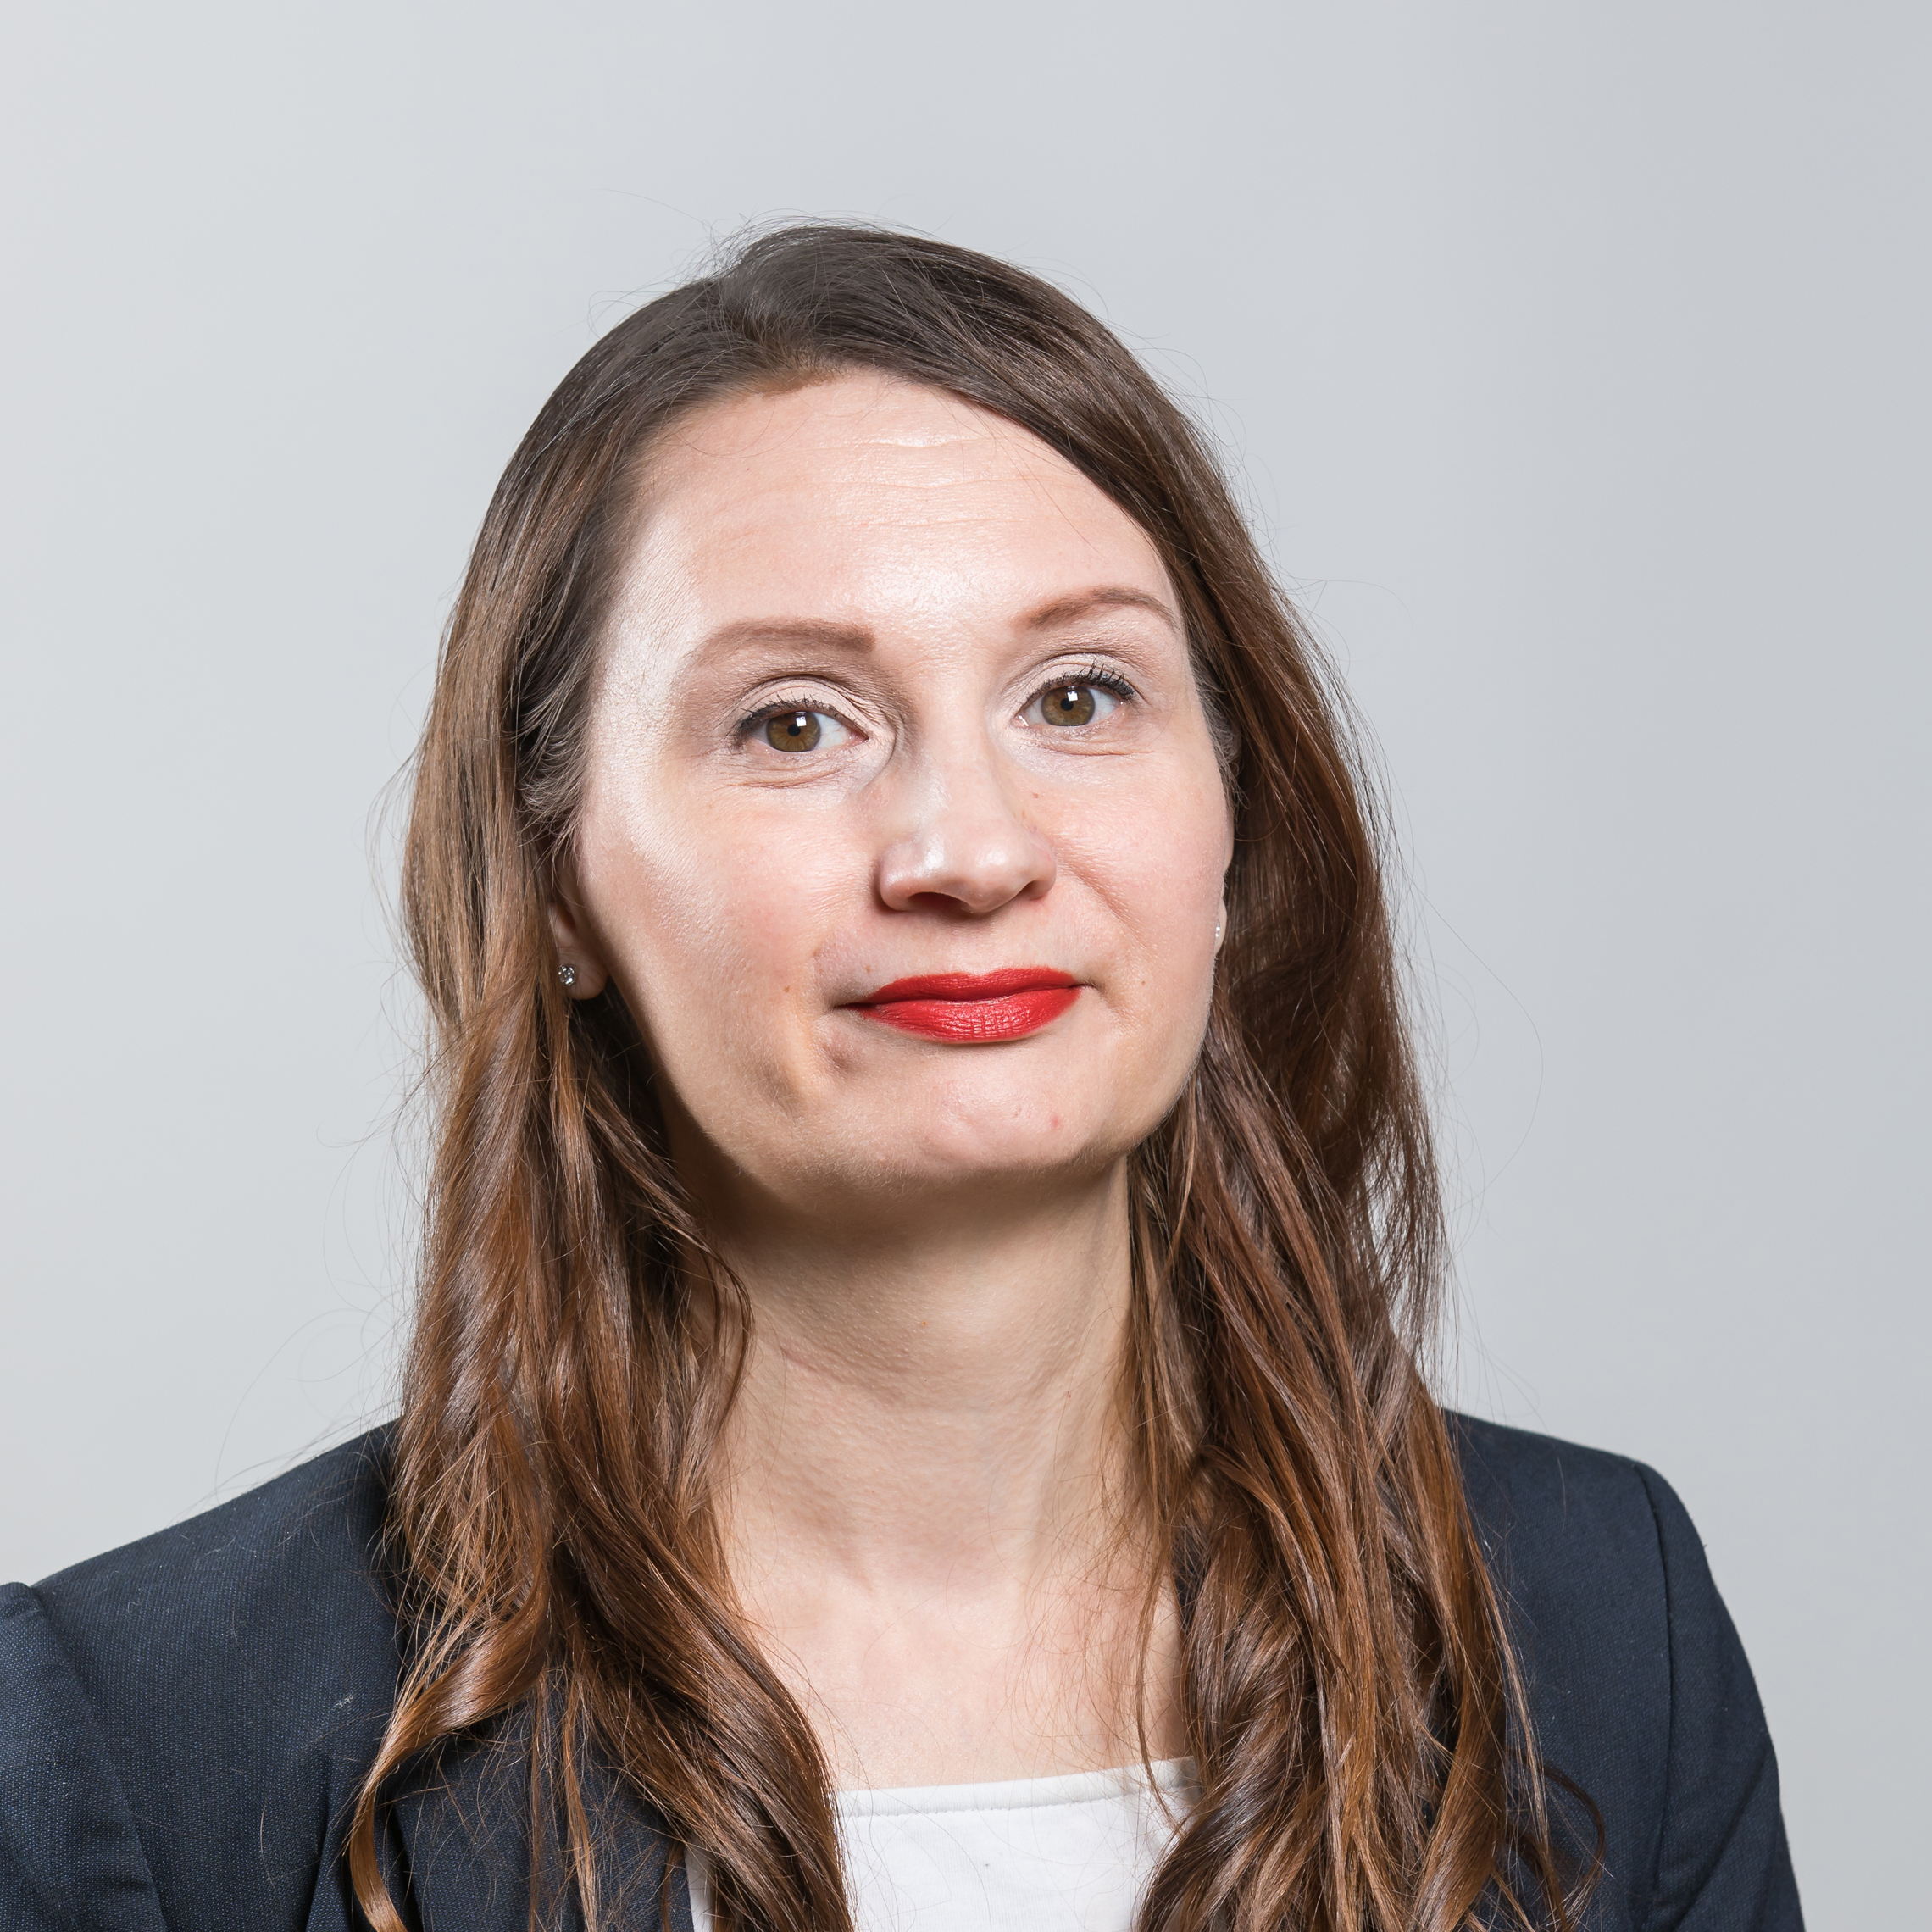
Our contacts
Kaakkois-Suomen Ammattikorkeakoulu Oy xamk.fi
Business ID 2472908-2 VAT number FI24729082
I speak cybersec
Krista Pesonen
RDI Specialist, CyberSecurity
krista.pesonen@xamk.fi
I speak project
Marie Skavø-Sinisalo
Project Manager
marie.skavo-sinisalo@xamk.fi
+358 45 11 33787

