Slide 1
Verkís Consulting Engineers
Bjarni Freyr Guðmundsson
Business Development

Slide 2
Verkís Consulting Engineers
RT-Rafagnatækni
Founded 1961
Fjarhitun
Founded 1962
Fjölhönnun
Founded 1970
1932 ´40 ´50 ´60 ´70 ´80 ´90 2000 ´10 ´20
VST
Founded 1932
Rafteikning
Founded 1965
Almenna
Founded 1971
Verkís was formed 2008 by merging of five consulting companies and 2013 one more joint the company.
300 employees
Turnover 2019: 37 MUSD
Dated back to 1932, being the oldest engineering company in Iceland.

Slide 3
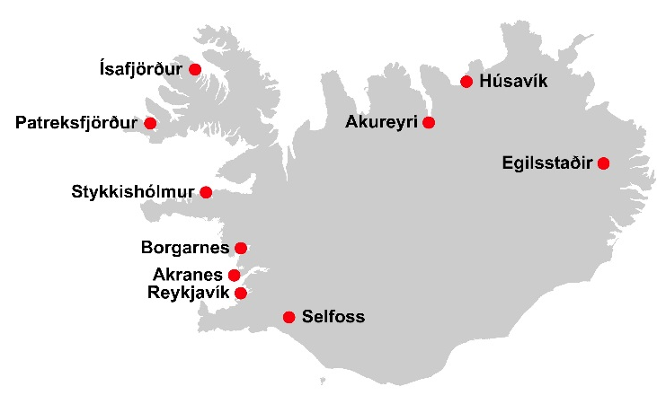
Headquarters
Ofanleiti 2 - 103 Reykjavík - Iceland
Branches Akranes – Borgarnes – Stykkishólmur - Patreksfjörður – Ísafjörður – Akureyri – Húsavík – Egilsstaðir - Selfoss
Verkís abroad Norway, Greenland, Georgia, Bulgaria, Poland, Ukraine and Chile

Slide 4
Among our clients Our regular customers are both private companies, municipalities, banks and government organizations

Slide 5
Services

Slide 6
Services
Project Management
Project control, risk and cost assessment and planning
Feasibility studies and conceptual design
Design - Sketch phase, pilot projects,
Assessment of environmental impacts
Purchasing
Management of construction
Health, safety and environment
Testing and approval
Training end education

Slide 7
Geothermal Consultants World leader in Geothermal District Heating Design
Small Businesses Creating value for communities
Multiple Use Snow-melting
Training Sharing our knowledge
Geothermal Pumping Optimization of all components
Domestic Heating Efficient and modern solutions
Cascaded Use Well-being and energy efficiency
Capacity Building Enabling new leaders in geothermal
Distribution Systems Optimized and energy efficient systems

Slide 8
Hydropower
Kárahnjúkar, Iceland – 690 MW
Blanda, Iceland – 150 MW
Qorlortorsuaq, Greenland - 7,6 MW
Búrfell, Iceland – 270 MW
Núpsvirkjun & Hvammsvirkjun, Iceand
Vatnsfellsvirkjun, Iceland – 90 MW

Slide 9
Geothermal Energy
Svartsengi
Reykjanes
Hellisheiði
Nesjavellir
Krafla
El Salvador

Slide 10
District Heating systems
Reykjavík district heating system
Nesjavellir main pipeline hot water
Vatnsendi pumping station
Reykir main pipeline hot water
Árbær pumping station
Xiang Yang district heating system

Slide 11
Schools – Swimming Pools – Sport Centers
Hofsós swimming pool
Ingunnarskóli – Primary School
Blue Lagoon Spa og Health center
Laugardalur Swim and Sport center
Laugar – Health and Sport Center
Reykjavik University

Slide 12
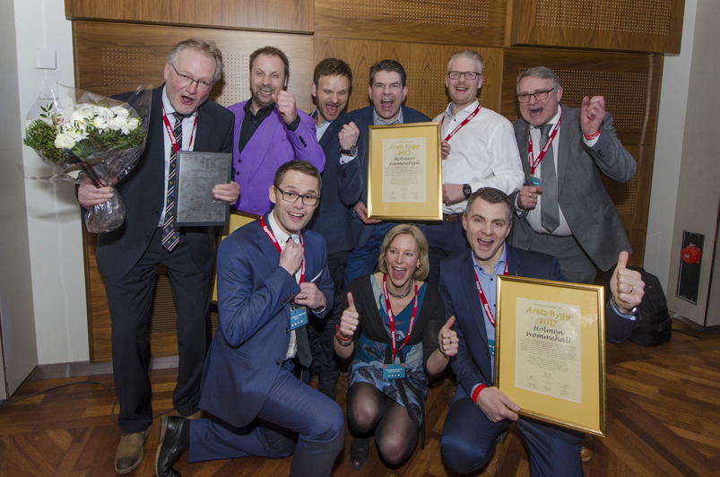
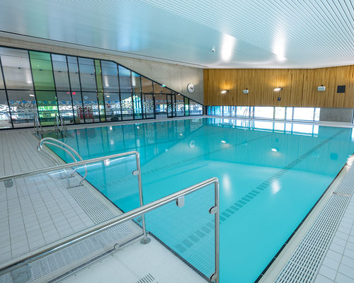
Buildings & Facilities Smart & Sustainable Solutions
Holmen swimming pool
Building of the year in Norway 2017 National Building Forum in Oslo in March 2018
Verkis a leading role Engineering | Project management | BIM | Supervision | Geotechnical engineering
Sustainable design
Swimming facility as a passive-solar-building
650 m² of solar panels installed on the roof and walls of the facility
15 geothermal energy wells (about 200 m deep) for power generation
Use of low carbon concrete
Heat recovery from gray water with heat pumps from ventilation systems
Information about energy consumption and power generation on a screen in the lobby

Slide 13
Verkefni erlendis

