Slide 1
STRONG PARTNER WITH A GOOD NETWORK
Łukasz Gawron, Karpacz, September 2024

Slide 2
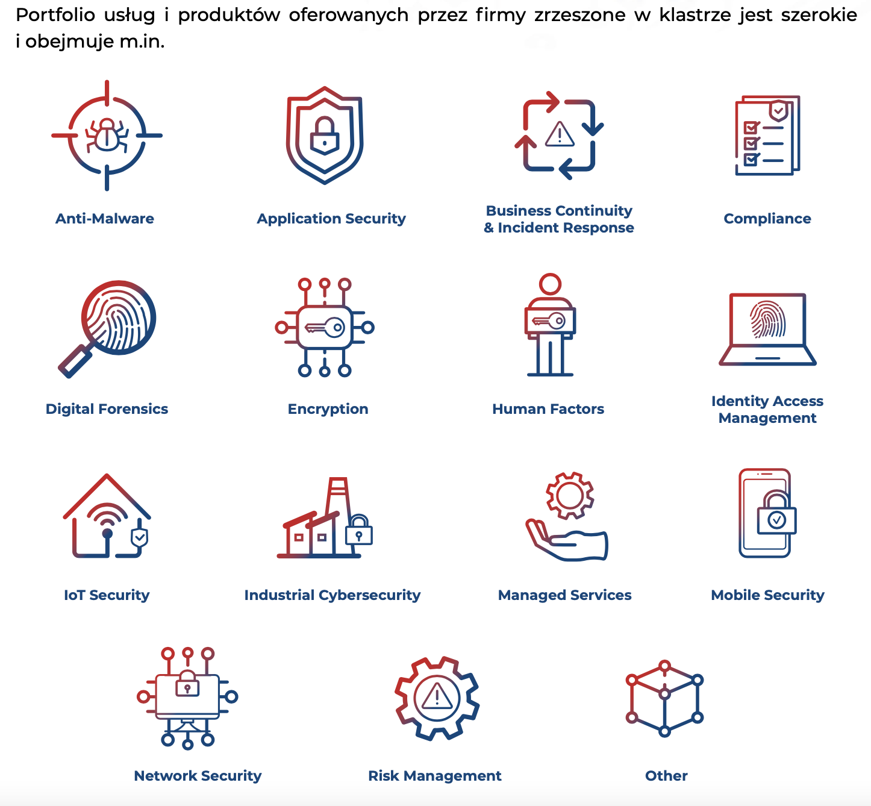
Polish Cybersecurity Cluster
The #CyberMadeInPoland cluster was created as a platform for cooperation and promotion of the Polish cybersecurity industry. Its purpose is to shape and develop safe cyberspace in Poland and to promote Polish companies abroad. The cluster also aims to stimulate the cooperation of the sector with scientific institutions, public administration entities, international corporations, industry and trade chambers, and other partners.

Slide 3
Polish Cybersecurity Cluster
60+ companies
30+ Partners
(IOB, VC&CVC, universities, indsutry associations, law firms)
2 ongoing European projects
4 years on the market

Slide 4
WHAT WE CAN BRING TO THE CONSORTIUM?
Strong network of business, academia, NGOs in Poland
Market knowledge
Practical workshops, trainings, cyber-ranges
Networking & matchmaking events, conferences, meet-ups, EXPO trade fairs
White papers, reports, analysis
Dissemintation & Communication
Synergis with other initiatives

Slide 5
WHICH PROJECTS ARE INTERESTING FOR US?
We offer: conducting practical workshops on the barriers to implementing the NIS2 directive, training on the practical implementation of NIS2 in organizations from both a technological and organizational perspective, co-organizing practical workshops, including cyber range, communication, and promotion.
We offer: support in co-organizing practical workshops on OT security, preparing reports and white papers on the state of OT security, recommendations, and best practices, as well as communication and promotion.
We offer: organizing networking events, matchmaking in the Polish market, communication, and promotion.

